Slide 1
Deep Learning: using recurrent neural network for sequential learning
Yifei Huang
2017-10-20

Slide 2

Neural Network

Slide 3
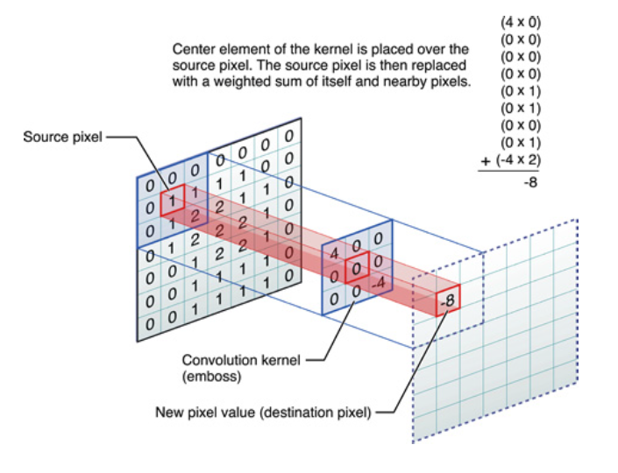
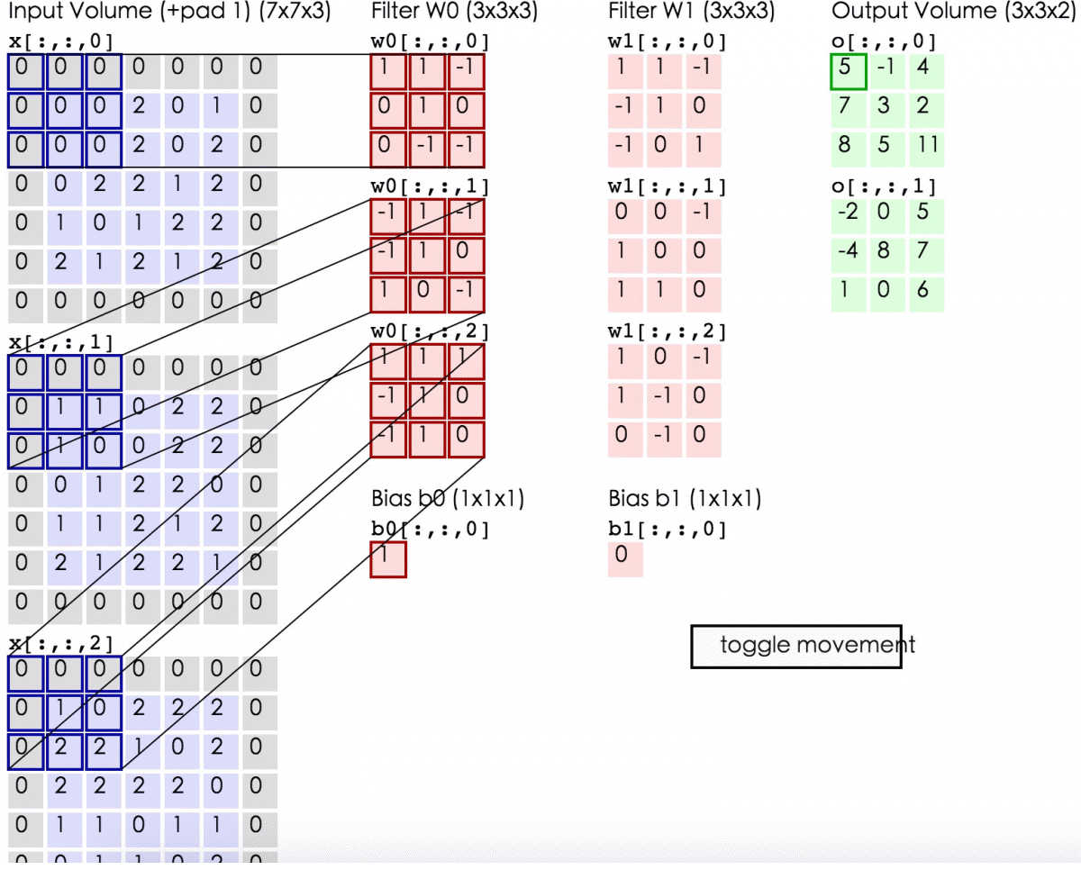
Convolutional Neural Network

Slide 4

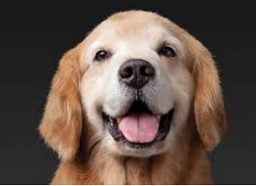
CNN vs RNN
H
E
CAT 90%
DOG 1%
…
E
L
CAT 5%
DOG 85%
…
L
L
L
O ? L?
Img CNN:
independent (input, output), fixed input size
Sequential Input:
output depends on Input + previous status, input size not fixed
O
<end>

Slide 5
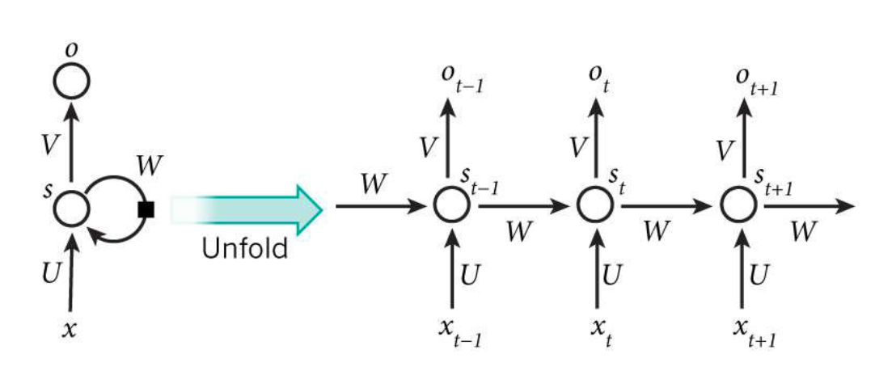
Recurrent Neural Network
S_{t} = f(W * S_{t-1} + U * X_{t})
O_{t} = f(V * S_{t})

Slide 6
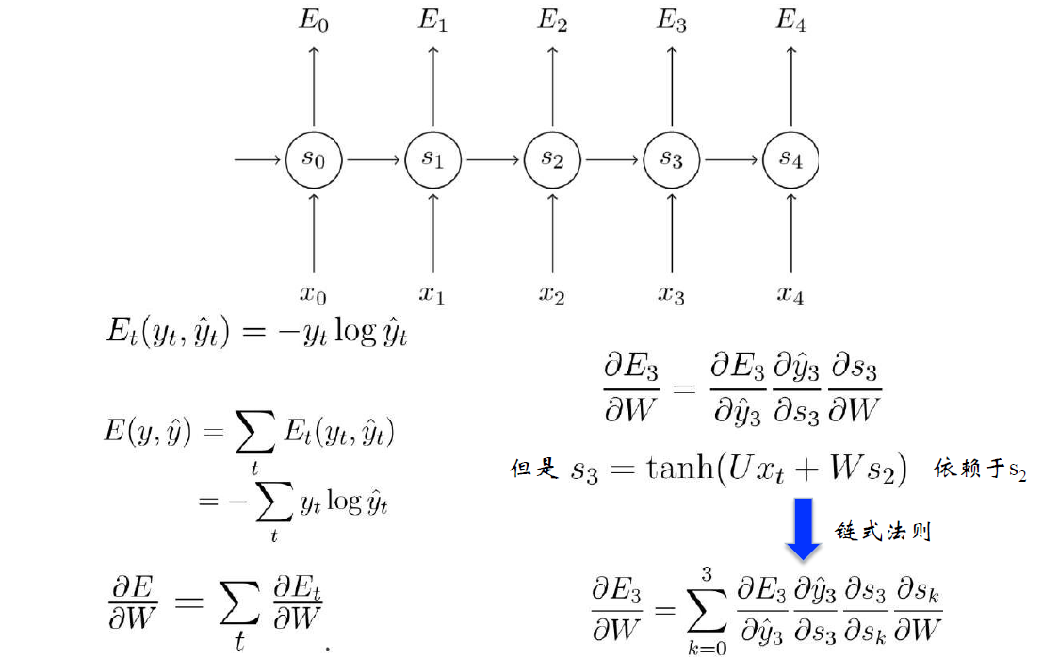
Back Propagation Through Time (BPTT)
V
V
V
V
V
W
W
W
W
W
U
U
U
U
U

Slide 7
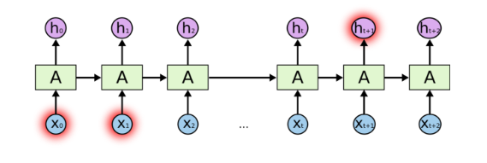
Gradient Explosion/ Vanish
Shanghai is administratively equal to a province and is divided into 16 county-level districts. Even though every district has its own urban core, the real city center is between Bund to the east, Nanjing Rd to the north, Old City Temple and Huaihai Road to the south. Prominent central business areas include Lujiazui on the east bank of the Huangpu River, and The Bund and Hongqiao areas in the west bank of the Huangpu River. The city hall and major administration units are located in Huangpu District, which also serve as a commercial area, including the famous Nanjing Road. Other major commercial areas include Xintiandi and the classy Huaihai Road (previously Avenue Joffre) in Huangpu District and Xujiahui (formerly Romanized as Zikawei or Siccawei, reflecting the Shanghainese pronunciation) in Xuhui District. Many universities in Shanghai are located in residential areas of Yangpu District and Putuo District.
(from Wikipedia)
dE/dW = f’(S_{t-1})* f’(S_{t-2})* f’(S_{t-3}) * … *f’(S_{t-n})
f’(S) >1 ➔ explosion
f’(S) <1 ➔ vanish
tanh(), sigmoid(), ReLU()

Slide 8
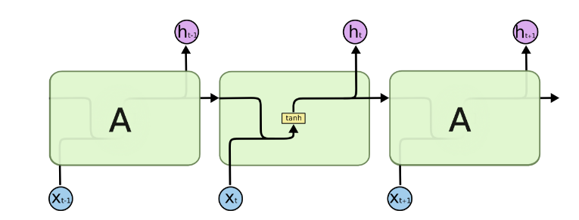
Vanilla RNN

Slide 9
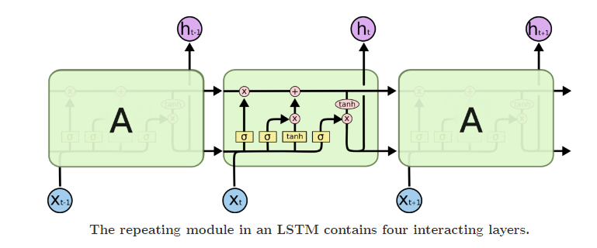
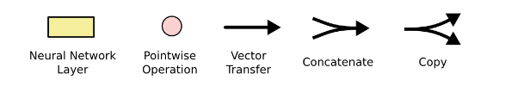
LSTM (Long-Short-Term-Memory)

Slide 10
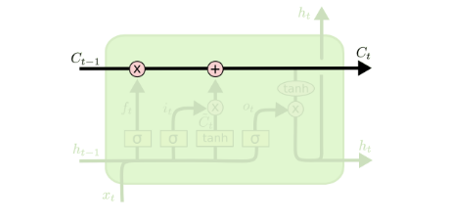
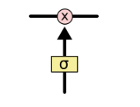
Hidden state pass

Slide 11
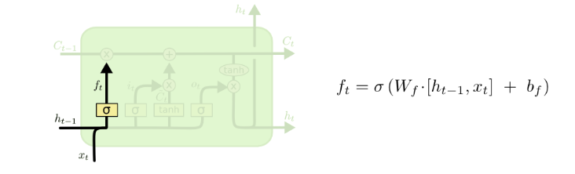
Forget Gate

Slide 12
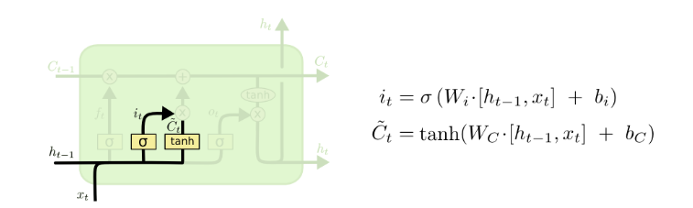
Input Gate

Slide 13
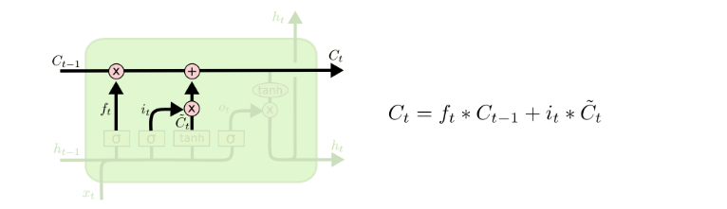
Hidden state update

Slide 14
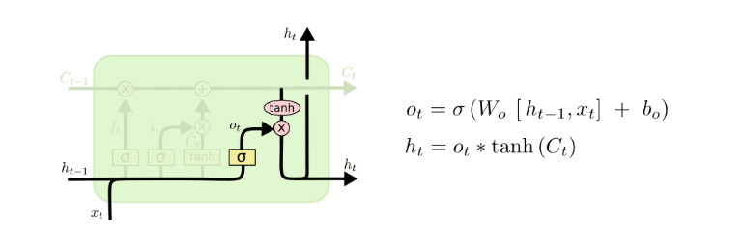
Output Gate

Slide 15
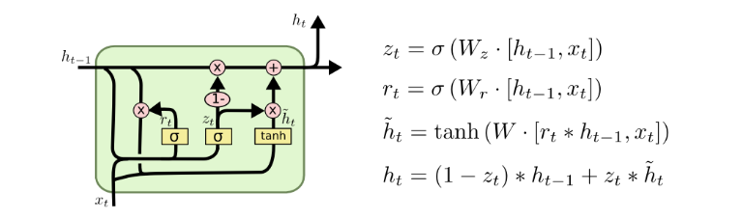
GRU

Slide 16
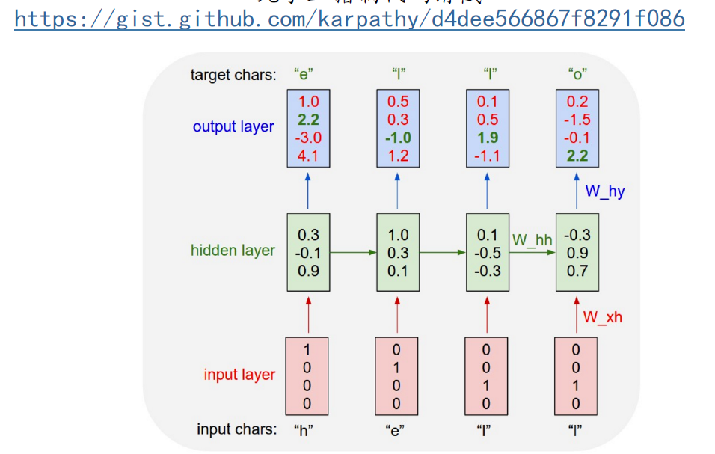
Char-RNN

Slide 17
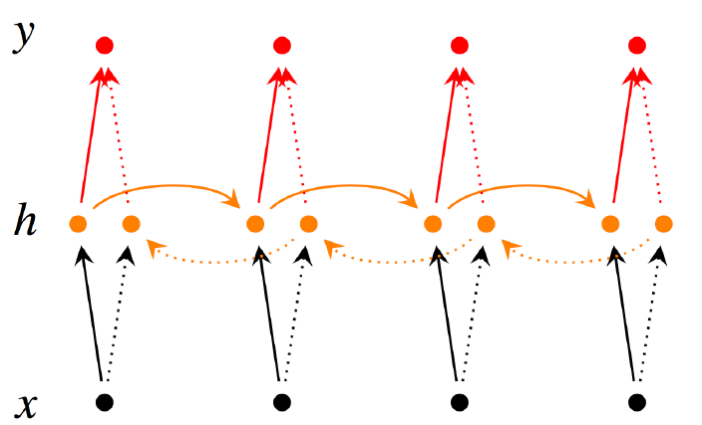
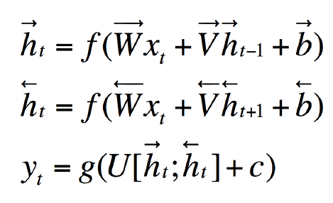
Bi-Direction RNN

Slide 18
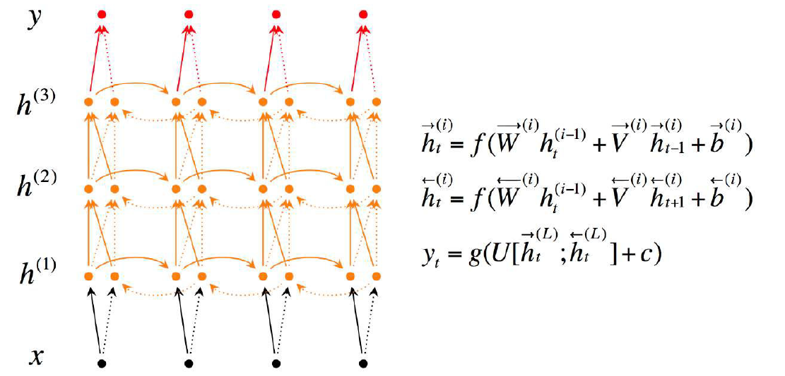
Bi-Direction + Multi Layer RNN

Slide 19
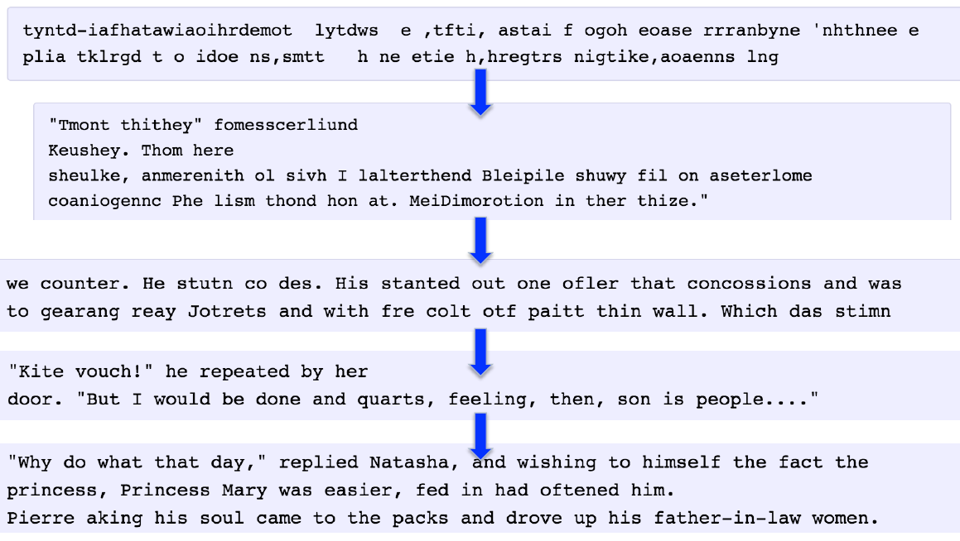
Example

Slide 20

Example

Slide 21
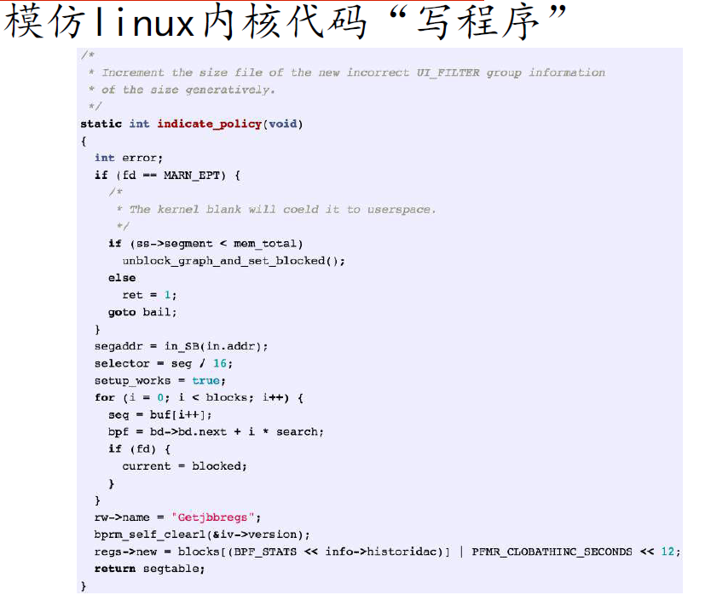

Slide 22
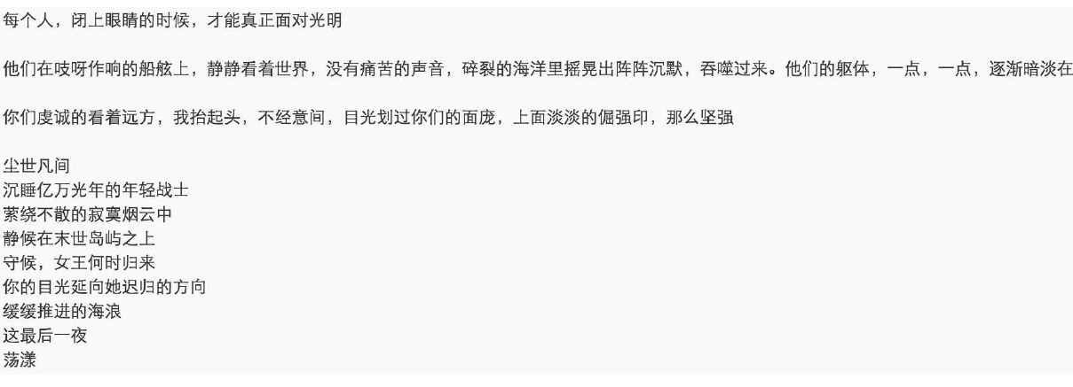

Slide 23
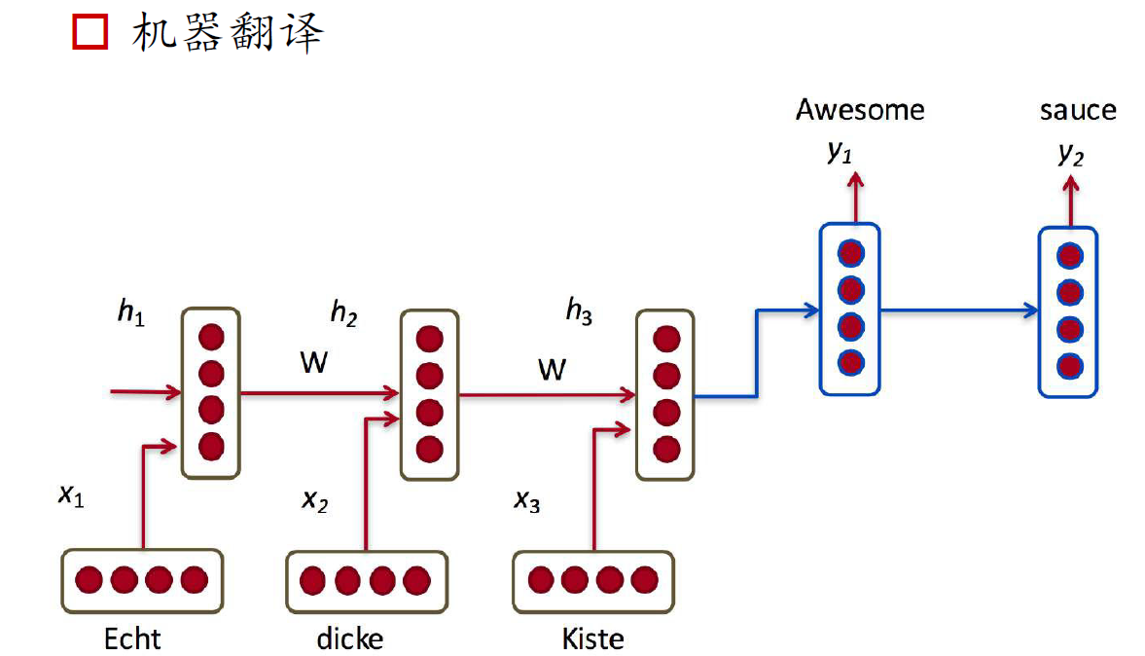

Slide 24
Ref
http://colah.github.io/posts/2015-08-Understanding-LSTMs/
http://www.deeplearningbook.org/contents/rnn.html
https://www.youtube.com/watch?v=6niqTuYFZLQ

